Slide 1
MLSA FULL STACK INTERNSHIP
NAME: YOGITA
ROLL NO.: 2300290120291
2nd YEAR

Slide 2
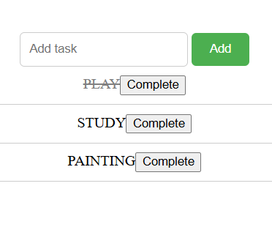
PROJECT 1 : TO DO LIST (EASY)

Slide 3
TECHNOLOGY USED
HTML
STRUCTURE THE LAYOUT OF THE TO DO LIST
CSS
FOR STYLING
JAVASCRIPT
TO MAKE THE WEB PAGE INTERACTIVE

Slide 4
FEATURES
ADD A TASK
MARK THE TASK AS COMPLETE
MINIMAL RESOURCE USED
AUTOMATIC INPUT RESET

Slide 5
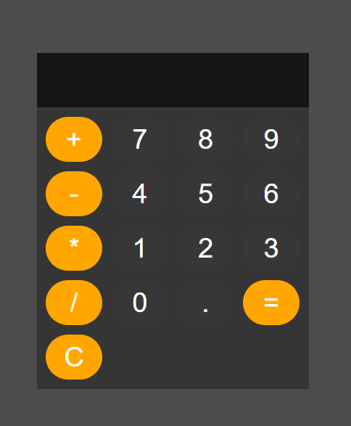
PROJECT 2 : BASIC CALCULATOR (INTERMEDIATE)

Slide 6
TECHNOLOGY USED
HTML
STRUCTURE THE LAYOUT OF THE CALCULATOR
CSS
FOR STYLING
JAVASCRIPT
IMPLEMENT THE CALCULATOR'S FUNCTIONALITY

Slide 7
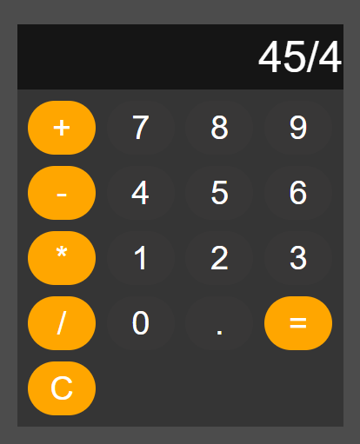
FEATURES
PERFORMS BASIC ARITHMETIC OPERATIONS
CLEAR FUNCTIONALITY
RESPONSIVE LAYOUT

Slide 8
THANK
YOU !!

